Slide 1
5.2 Language Translators
assembler software for the translation of an assembly language program
a compiler for the translation of a high-level language program
an interpreter for translation and execution of a high-level language program
Explain the benefits and drawbacks of using either a compiler or interpreter and justify the use of each
Show awareness that high-level language programs may be partially compiled and partially interpreted, such as Java
Describe features found in a typical Integrated Development Environment (IDE)
for initial error detection, including dynamic syntax checks
for presentation, including prettyprint, expand and collapse code blocks
for debugging, including single stepping, breakpoints, i.e. variables, expressions, report window

Slide 2
Today
assembler software for the translation of an assembly language program
a compiler for the translation of a high-level language program
an interpreter for translation and execution of a high-level language program
Explain the benefits and drawbacks of using either a compiler or interpreter and justify the use of each
Understand: Why we need translations?
Able: Know the benefits of different translator types
Answer: Is there only one type?

Slide 3
Language
What does this say?
Бұл мен аударуда қолданатын кездейсоқ мәтін
How about this:
这是我用来翻译的一些随机文本
And now?
This is some random text that I'm using to translate
It (should be) the same sentence in Kazakh, Mandarin and English.
But why could you not read the Kazakh?

Slide 4
Language
Can a computer understand:
5
No, it can only understand Binary, so 5 is really 0 1 0 1.
So everything we do needs to converted into Binary
But we don’t say converted, we have to say it gets translated into Binary
There are three types of translators that do the translating
Assembler
Interpreter
Compiler

Slide 5
Assembler
The first type of translator is an Assembler.
An Assembler only translates Assembly Language.
Assembly Language is considered as a Low Level Language
We actually did this in Unit 4.2 – Assembly Language, so we will do it again but quickly.

Slide 6
Assembler
So Assembly language is code.
The code is made from two parts
Opcode
Operand
This assembly language code then has to be translated into machine code (binary)
The job of translating assembly language is done by the Assembler.
There are two types of assembler
One Pass Assembler
Two Pass Assembler

Slide 7
One Pass
Okay, this is where Cambridge wants me to explain: “What is a one-pass assembler” but really what they want is about a Load-and-go assembler.
Load-and-go Assembler
You write your assembly code
The assembler looks at each line
Right away it executes each line
+ Fast. Because it does things right away
- Stupid. Because it does not check for errors
- Stupid, no forward referencing

Slide 8
Real one-pass assembler
So if load-and-go is too stupid, then we can use a one pass assembler.
One-pass assembler
Reads all your code one time
As it reads your code it builds two tables. An Opcode Table and a Symbol table
The opcode table just says “oh you typed in 107, it means ADD something”
So ADD is put in the table
We want to add whatever is in memory location 07, so 07 is put in the symbol table
3. When it finishes building the tables, then your code is run
+ Fast, only one pass
+ If there’s any errors it can see
- Cannot handle forward referencing

Slide 9
Interpreter and Compiler
An interpreter is one way to translate a high level language
A compiler is another way to translate a high level language
We code in high level languages. C, C#, C++, Python, Visual Basic, HTML, Java, Java Script are all types of High Level Languages
High Level Language (HLL) = Code written that looks similar to English

Slide 10
Video Questions:
Q1. To get a computer to understand you, what has to be translated?
Q2. How many types of translator are there?
Q3. Name the different translators
Q4. Instead of Gobbldy-Gook, what language does it actually get translated into?
Q5. True or false, the interpreter leaves you.
Q6. Using an interpreter means you cannot correct your mistake. True or False?
Q7. What is the main difference the compiler has over other translator
Q8. True or false, the compiler stays with you
Q9. When using a compiler, the mechanic has to wait for each instruction to be translated one by one. True or false?
Q10. Explain the advantages and disadvantages of the different translators types
Q11. What is one way to remember the way the interpreter works?
Q12. What is one way to remember the way the compiler works?
Q13. What part of a computer is the ‘mechanic’?
Q14. Which translator do you have to use in modern computers?

Slide 11


Slide 12
Video Questions:
Q1. To get a computer to understand you, what has to be translated?
Q2. How many types of translator are there?
Q3. Name the different translators
Q4. Instead of Gobbldy-Gook, what language does it actually get translated into?
Q5. True or false, the interpreter leaves you.
Q6. Using an interpreter means you cannot correct your mistake. True or False?
Q7. What is the main difference the compiler has over other translator
Q8. True or false, the compiler stays with you
Q9. When using a compiler, the mechanic has to wait for each instruction to be translated one by one. True or false?
Q10. Explain the advantages and disadvantages of the different translators types
Q11. What is one way to remember the way the interpreter works?
Q12. What is one way to remember the way the compiler works?
Q13. What part of a computer is the ‘mechanic’?
Q14. Which translator do you have to use in modern computers?

Slide 13
Extra info - Interpreter
Interpreter:
Translates line by line
Quick to start
If it finds an error it stops right away
Not portable. Your code and the interpreter must be together

Slide 14
Extra info - Compiler
Reads all your code first
Translates everything in one time
Slow to start
If there’s an error, too bad.
Portable. When the translation is done, you can take your program to another computer and use it.
.exe files have been compiled.

Slide 15
Why Cambridge….Why?
Okay, these next bits are in your syllabus and, for a change, it is useful to know these things….. But they are only in your syllabus to make your course a little harder.

Slide 16
Today
Show awareness that high-level language programs may be partially compiled and partially interpreted, such as Java
Describe features found in a typical Integrated Development Environment (IDE)
for initial error detection, including dynamic syntax checks
for presentation, including prettyprint, expand and collapse code blocks
for debugging, including single stepping, breakpoints, i.e. variables, expressions, report window
Understand: What is JIT
Able: Explain Single Stepping and Breakpoints
Answer: What’s an IDE

Slide 17
Compiler and Interpreter
Compiler = All at once
Interpreter = Line by line
So, does it mean when you are making your program you can use a compiler or an interpreter or can you use both??
It depends on the High Level Language you use.
Most use compilers.
But there is one language that uses both. (Actually, it doesn’t really use both on the same code…..but you’ll see)
That language is JAVA

Slide 18
JAVA
JAVA is another HLL
With other HLL (C, Python, Visual Basic…) you take your code (called the source code) then the compiler looks at your source code and translates it into binary (called the machine code)
So it goes:
SOURCE CODE ->
COMPILER ->
MACHINE CODE
Now the compiler does many things to get to machine code, but we will learn this in a different unit.
But JAVA does things differently

Slide 19
JAVA
Java does NOT do SOURCE CODE -> COMPILER -> MACHINE CODE
It does:
SOURCE ->
COMPILER ->
JAVA BYTECODE ->
JAVA VIRTUAL MACHINE ->
MACHINE CODE

Slide 20
JAVA BYTECODE AND JVM
SOURCE ->
COMPILER ->
JAVA BYTECODE ->
JAVA VIRTUAL MACHINE ->
MACHINE CODE
You take your source code, the thing you wrote.
It gets compiled into another language called bytecode
Then this bytecode gets sent to the JVM, Java Virtual Machine
Then the JVM looks at this bytecode and then behaves as an interpreter, doing the bytecode instructions line by line
This whole method is called JIT – Just In Time Compiler

Slide 21
Why?
Why do these extra steps?
Good question.
The idea was that Java can be COMPLIED into bytecode and that this bytecode goes to the JVM and then gets INTERPRETED, they felt it was quicker to do this then directly compile into machine code
That if the bytecode had many common instructions then its easier to do it this way.
Is it true? Well Java is popular so maybe its true, but really a lot of CS and programming is just people trying to show off that they know something so they make things more complicated then needed.

Slide 22
What about your program?
So do you get to choose if you use a compiler or interpreter?
Well, its all part of your IDE
IDE = Integrated Development Environment
It’s a stupid name, but it is useful.

Slide 23
IDE
Let’s say you want to make a program for your laptop
You need:
Software you can type your code into (text editor)
Compiler or interpreter
Automation tools. To help you code quicker
Debugger. To check for errors
So now you need at least 4 things to make one program.
An IDE is one big program that has all of these features built in, so you don’t have to switch programs, everything is in one place.
Example video:

Slide 24
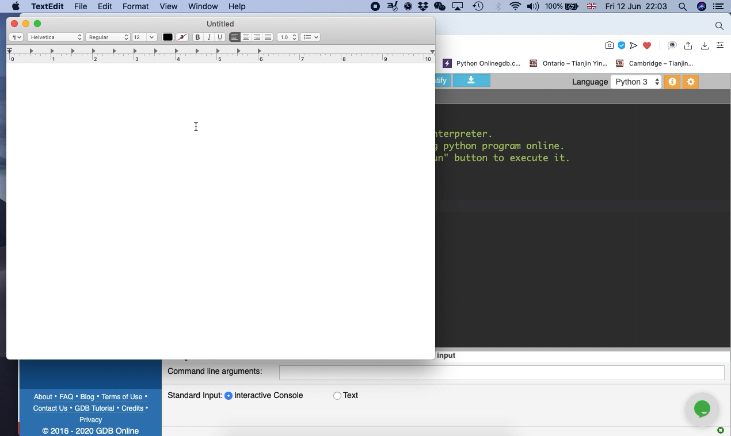

Slide 25
Some more features of an IDE
Context – Sensitive Prompt
When something comes up on screen based on what you are doing.
Example, that menu came up when I was typing in “print”
Initial Error Detection
Your IDE will check for errors when you ask for it
Dynamic Syntax Checks
Your IDE checks for syntax (grammar) errors as you type. So, if you wanted to PRINT but you wrote PNT instead, it will show this as an error as you are typing.

Slide 26
IDE Features
PrettyPrint
When you use indents (spaces) to make your code look more beautiful
Expand and Collapse Blocks
When you can show or hide pieces of code

Slide 27
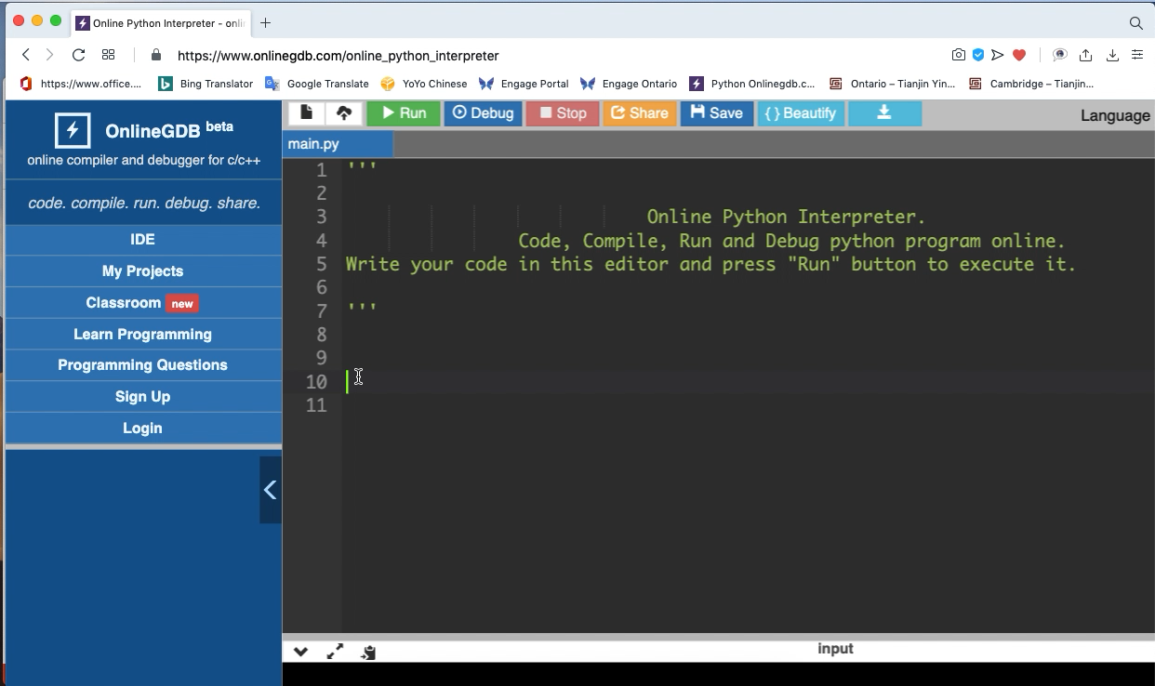

Slide 28
IDE Debugging
As part of your IDE, there is a debugger.
A debugger looks at your code and checks it for mistakes.
Do not confuse with compiler or interpreter which translates your code
Its just that a debugger will usually run first then your compiler or interpreter will translate if your code is perfect.

Slide 29
Types of debugging:
Single Stepping:
Each block of your code is checked one by one.
Breakpoint
You put special code into your code that tells the debugger “when you get to this point, stop and open the debugging / report window”
Debugging window / report window
Its where the debugger shows you where the mistake is.

